Slide 1
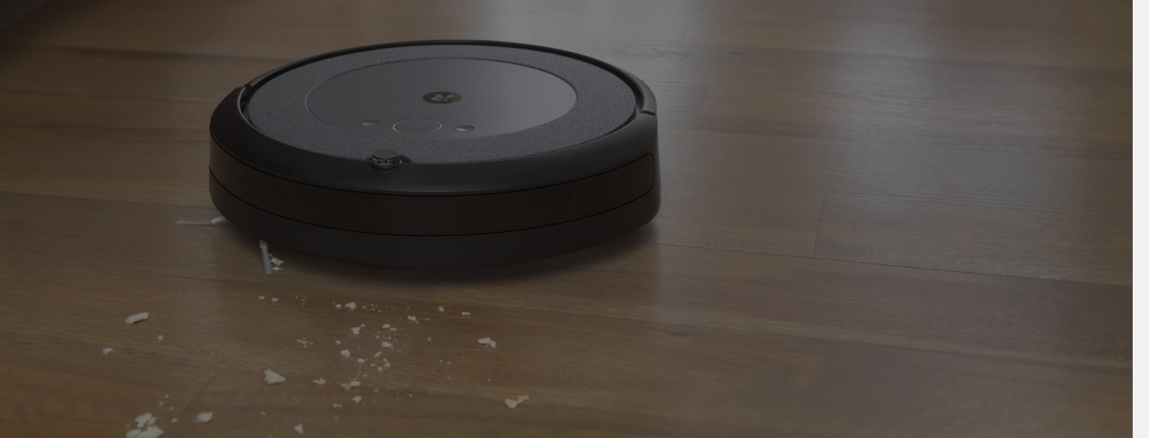
RVC
Robot Vacuum Cleaner

Slide 2
RVC system
System point of view
As if we were a company producing the RVC system
Roomba, Dyson, Ariete, Moulinex, ..

Slide 3
Req document
Stakeholders
Context diagram + interfaces
FR + NFR
UCD + UC + scenarios
Glossary
System design
Deployment diagram

Slide 4
Stakeholders
End users (customers who will use the RVC system)
Component producers
Retailers (mediaworld ..)
Competitors
Std for power supply
Environment (houses or offices or industrial?)
Inside company
Marketing office
Design office
Software office
Engineering office

Slide 5
Context diagram
Actor: end user (active)
Actor: power supply
Actor: maintenance server (passive)
Actor: obstacle, gap (passive)
interfaces
Actor | Log interface | Physical interface
End user | Start stop , .. | 3 buttons
Power supply |  | Plug schuko 3 poles, 220v
Maintenance server of producer company | Look for update, install update | Wifi connection
Obstacle, gap | Recognize obstacle or gap | IR used by sensor

Slide 6
Functional requirement (system level)
Clean floors of house in autonomous way (without human intervention)

Slide 7
Non functional req
Countries where the system will be sold: Europe, USA, ..
Will induce choices on power supply, like 110V 220V, 50 60hz, plugs and cords
Will induce constraints on certifications, like CE label, ..
Usability
Any non technical person should be able to use the system without training
Efficiency
power consumption less than 40w
Min surface of house that can be cleaned with no interruption = 100sqm
Will induce NF req on capacity of battery, power of engines etc
Will induce NF req on consumption of ‘software’
Safety: no harm to people, animals, objects
Speed of robot no more than .. m/sec

Slide 8
Domain requirements
(hidden requirements about the domain)
Floor of house is flat
Floor of house is mildly dirty (no heavy dirt like in industrial environment)
No liquids on floor

Slide 9
Note about NFR: these NFR are system level, so do not follow the taxonomy of sw requirements (ISO 9126, maintainability portability efficiency …)
Note about FR: the system is actually just an aggregate of robot, charging station, mobile app, most of the FR are allocated to robot and mobile app. In the following FRs are grouped per robot and mobile app

Slide 10
F requirements (Robot level)
Monitor safety
Monitor speed and limit it to .. m/sec
Stop if obstacle encountered
Force shutdown in case of harmful situation
Manage Energy
Read battery capacity
Estimate distance that can be travelled with current capacity
Monitor recharge of battery
Manage upgrades
Check if upgrade is available
Read current version number
Download firmware upgrade
Install firmware upgrade
Self test
Check each component (sensors, engines, ..) a, b .. and notify defects in case of.
Manage remote communications
Send / receive messages with company server

Slide 11
F requirements (Robot level)
Manage movement of robot
Move from position A (here) to position B
Define a turnaround of an obstacle
Define a turnaround of a gap
Cover (and clean) a surface
Define a path to cover all the surface
Follow a given path
Learn a house map of the surface of the house
Interrupt / resume a surface cover
Manage Obstacle
Recognize obstacle (fixed, movable, moving)
Recognize gap
Clean
Operate cleaning device
Check if floor is clean (feasible??)

Slide 12
F requirement (smartphone level)
Manage user interaction (on smartphone app)
Set robot On off
Start
Learn
Show history (when cleaned, how long)
Show consumption
Show path followed for cleaning
Show map and obstacles
Modify map
Define plan of cleanings for week / day / month

Slide 13
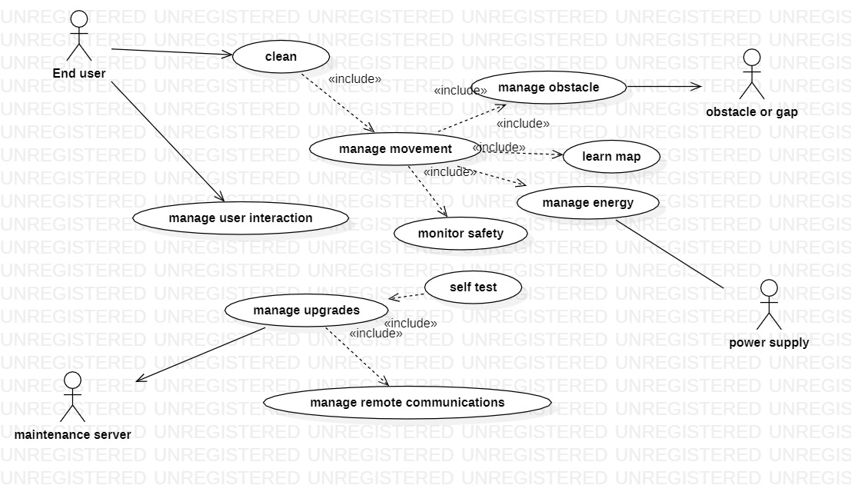
UCD

Slide 14
UC1 - clean
Precondition
Robot is ON
Robot is in charging station
Post condition
Robot is in charging station
Scenarios
UC1.1 Nominal: map is available, robot fully cleans the house, no unknown obstacles encountered
UC1.2 Exception: map is not available, no cleaning
UC1.3 Variant: map is available, battery not enough, robot cleans partially then returns for charging, then recovers cleaning
UC1.4 Variant: map is available, robot fully cleans the house, unknown obstacle is encountered and bypassed
UC1.5 Exception: map is available, unknown obstacle is encountered and cannot be bypassed, robot stops 10 seconds then returns to charging station, house partially uncleaned
UC1.6 Exception: map is available, self test not passed, robot remains at charging station

Slide 15
Map of house
A1 (charging station) | A2 | A3
B1 | B2 | B3
C1 | C2 | C3

Slide 16
UC1.1
Precondition
Robot is ON
Robot is in charging station
Battery is charged
Map of house is available (2d model made of tiles, tiles tagged as free/obstacle/gap)
Postcondition
Robot has cleaned the house (all tiles of house have been covered by robot path)
Robot is in charging station

Slide 17
UC1.1
Robot computes path to clean house, using available map (path = A1, A2, A3, B3, B2, B1, C1,C2,C3, B3 A3 A2 A1…)
Robot moves to A2 and cleans
Robot moves to A3 and cleans
……
Robot moves to A1 and stops

Slide 18
UC1.2
Precondition
Robot is ON
Robot is in charging station
Battery is charged
Map of house is not available
Postcondition
Robot has not cleaned the house
Robot is in charging station

Slide 19
UC1.2
Robot tries to compute path, map is not available
Robot does not move

Slide 20
UC1.3
Precondition
Robot is ON
Robot is in charging station
Battery is partially charged
Map of house is available (2d model made of tiles, tiles tagged as free/obstacle/gap)
Postcondition
Robot has cleaned the house (all tiles of house have been covered by robot path)
Robot is in charging station

Slide 21
UC1.3
Robot computes path to clean house, using available map (path = A1, A2, A3, B3, B2, B1, C1,C2,C3, B3 A3 A2 A1… assuming house is squared, 9 tiles, charging station in A1)
Robot moves to A2 and cleans
Robot moves to A3 and cleans
Robot recognizes battery level low
Robot computes path from A3 to A1 (A3, A2, A1)
Robot moves to A2
Robot moves to A1
Robot waits for battery charged
Robot computes path to A3 (where interrupted) (A1, A2, A3)
Robot moves to A2
Robot moves to A3
(recover cleaning) robot moves to B3 and cleans
(from now same as UC1.1)

Slide 22
UC1.4
Precondition
Robot is ON
Robot is in charging station
Battery is charged
Map of house is available (2d model made of tiles, tiles tagged as free/obstacle/gap)
Postcondition
Robot has cleaned the house (all tiles of house have been covered by robot path)
Robot is in charging station

Slide 23
UC1.4
Robot computes path to clean house (using UC manage movement), using available map (path = A1, A2, A3, B3, B2, B1, C1,C2,C3, B3 A3 A2 A1… assuming house is squared, 9 tiles, charging station in A1)
Robot moves to A2 (using UC manage movement) and cleans
Robot moves to A3 and cleans
Robot tries to reach B3 but finds obstacle (using UC manage obstacle)
Robot computes path to B2 avoiding B3 (A3, A2, B2) (using UC manage movement)
Robot moves to A2
Robot moves to B2 and cleans
From now on same as UC1.1

Slide 24
UC2 Manage upgrades
Precondition
Robot is on, robot is in charging station, idle
Scenarios
UC2.1 Nominal: check for upgrades on maintenance server, one is available, download, upgrade is ok, install
UC2.2 Variant: check for upgrades, none is available
UC2.3 Variant: check for upgrades, one is available, download, upgrade is corrupted, repeat download, upgrade is ok, install
UC2.4 Exception: check for upgrades, communication down, abort

Slide 25
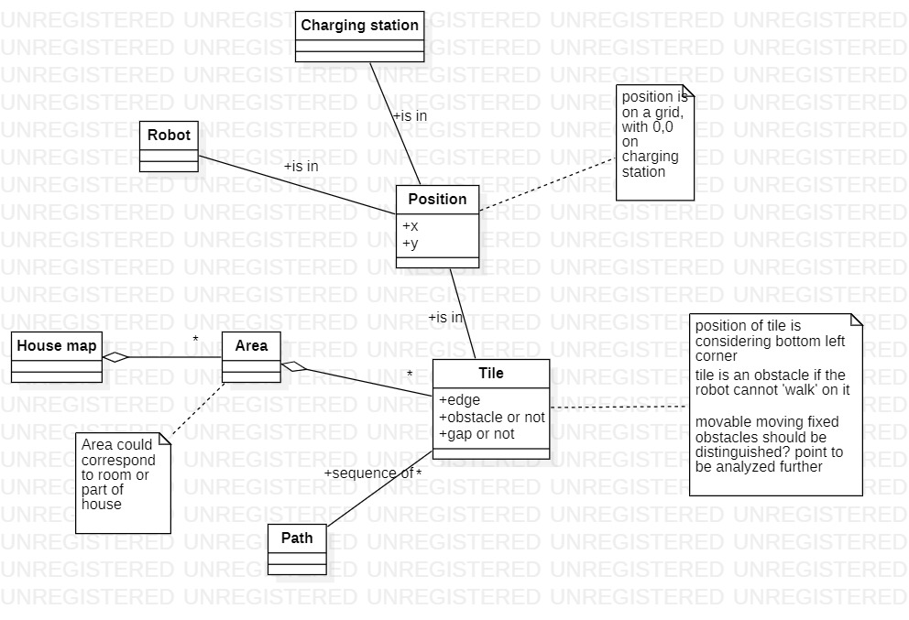
Glossary

Slide 26
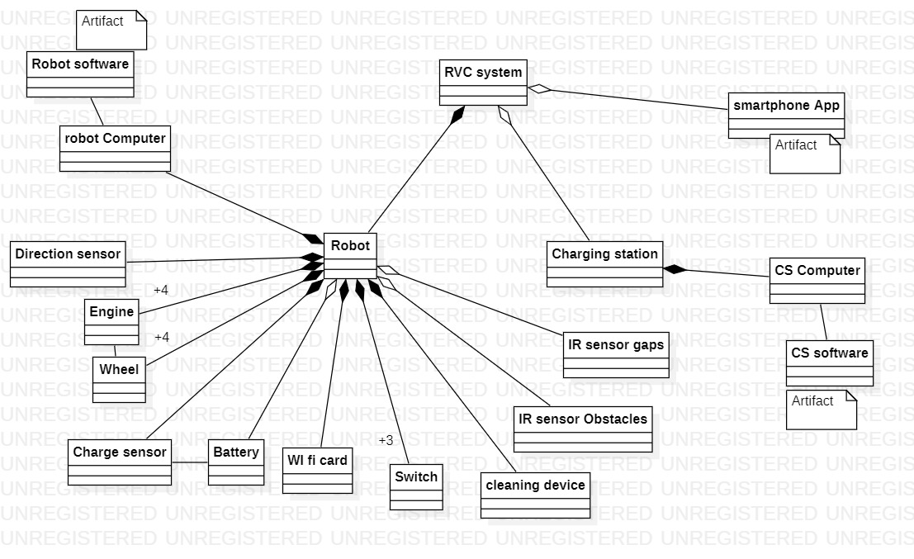
System design

Slide 27
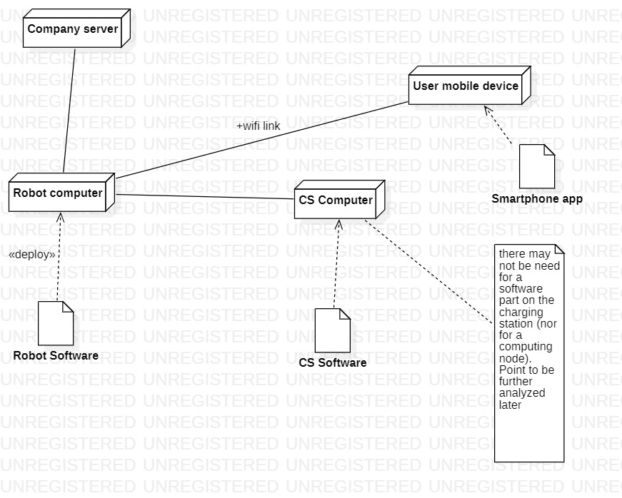
Deployment diagram

Slide 28
In the following each component of the system (robot, charging station, smartphone app) should be analysed producing a possibly complete requirement document
Robot
Context diagram, interfaces
FR, NFR
UCD
System design
Deployment diagram (not needed in this case)
Smartphone app
Context diagram, interfaces
FR, NFR
UCD
System design (not needed in this case)
Deployment diagram (not needed in this case)

Slide 29
Robot
Context diagram
User
Charging station
Obstacles
Maintenance server of company
FR
See slides 10, 11
Send / receive messages with smartphone app

